Slide 1
ADVERSARIAL SEARCH
By Miguel Leon

Slide 2
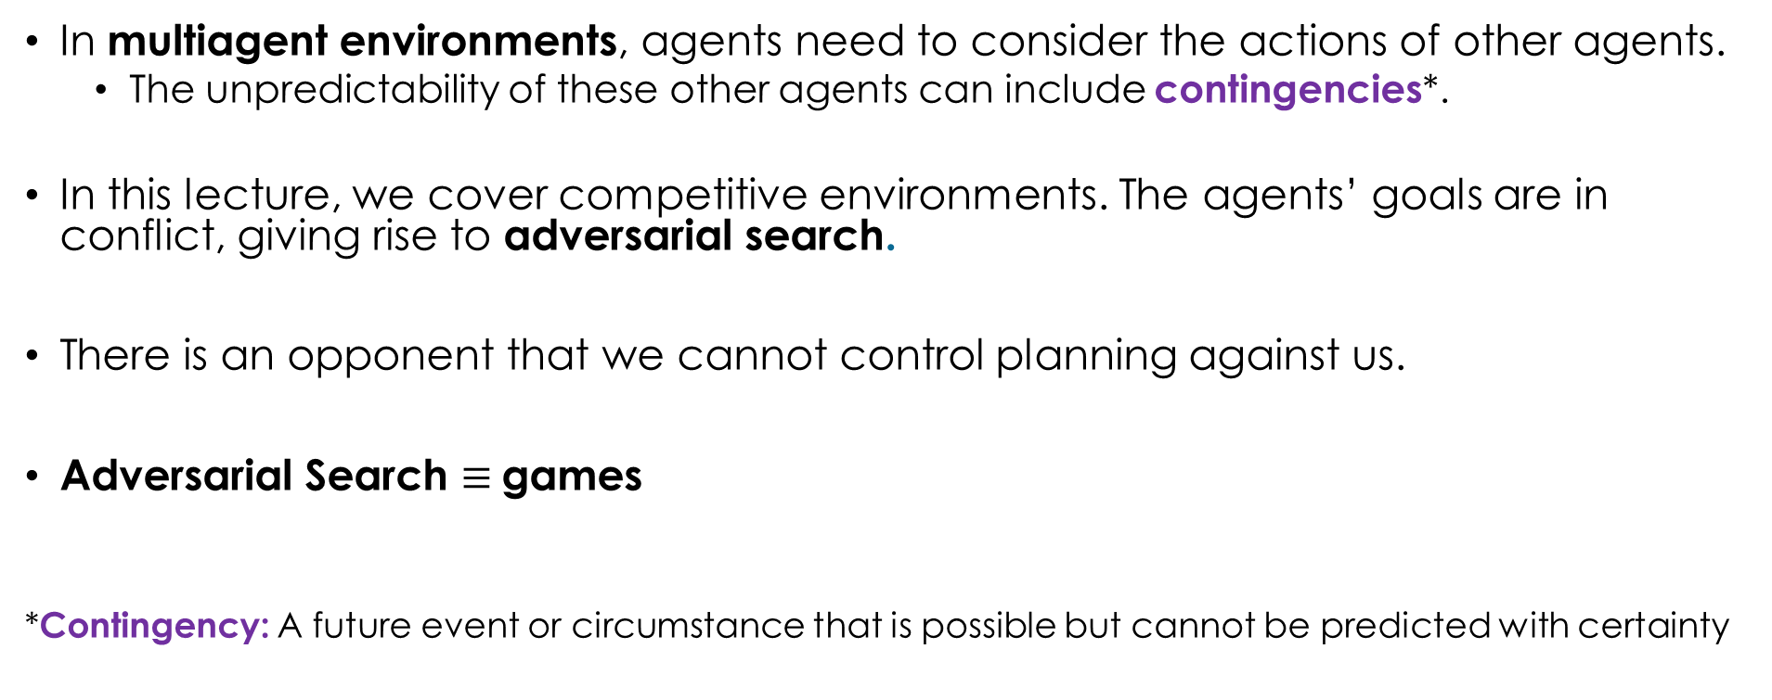
Adversarial search
In multiagent environments, agents need to consider the actions of other agents.
The unpredictability of these other agents can include contingencies*.
In this lecture, we cover competitive environments. The agents’ goals are in conflict, giving rise to adversarial search.
There is an opponent that we cannot control planning against us.
Adversarial Search $≡$games
*Contingency: A future event or circumstance that is possible but cannot be predicted with certainty

Slide 3
Games vs search problems
Unpredictable opponent → Solution is a strategy specifying a move for every possible opponent reply.
Coding options:
Hard code it. (Tedious and fragile).
Model the game as a search problem.
Time limits → Unlikely to find the goal
Solution: We have to approximate.
How to approximate:
Using heuristic evaluation functions.

Slide 4
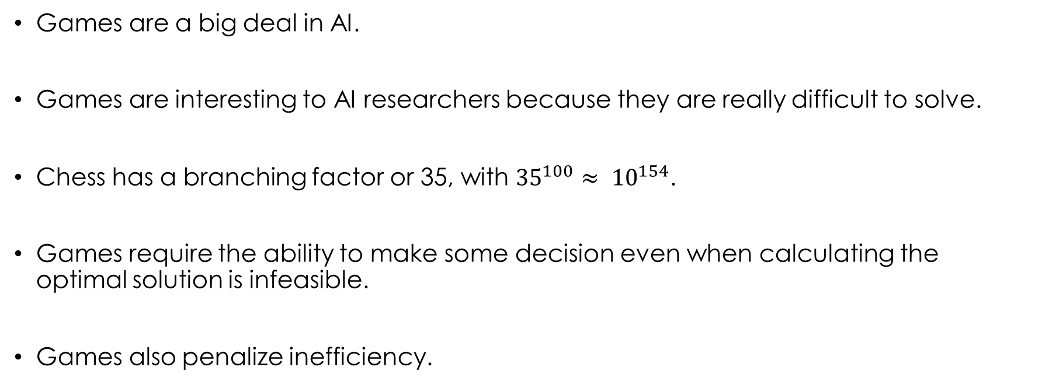
Games: hard topic
Games are a big deal in AI.
Games are interesting to AI researchers because they are really difficult to solve.
Chess has a branching factor or 35, with ${35}^{100}≈ {10}^{154}$.
Games require the ability to make some decision even when calculating the optimal solution is infeasible.
Games also penalize inefficiency.

Slide 5
Type of games
Perfect Information*:
Deterministic: Chess, checkers, go, Othello
Chance: Backgammon, monopoly
Imperfect information**:
Deterministic: Battleships, blind tic-tac-toe
Chance: Bridge, poker, scrabble, nuclear war
*Perfect Information: Everything is known for both players.
**Imperfect Information: Some information is hidden to the players

Slide 6
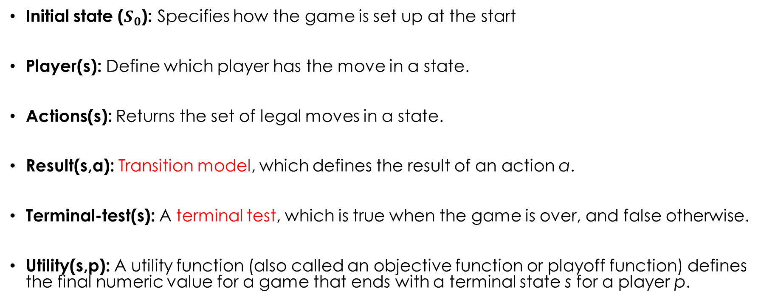
Definition of a game as a search problem
Initial state ($S_{0}$): Specifies how the game is set up at the start
Player(s): Define which player has the move in a state.
Actions(s): Returns the set of legal moves in a state.
Result(s,a): Transition model, which defines the result of an action a.
Terminal-test(s): A terminal test, which is true when the game is over, and false otherwise.
Utility(s,p): A utility function (also called an objective function or playoff function) defines the final numeric value for a game that ends with a terminal state s for a player p.

Slide 7
Example: Tic-tac-toe
Initial State:
Player(s):
Actions(s):
Result(s, a):
Terminal-test(s):
Utility(s, p):

Slide 8
Example: Tic-tac-toe
Initial State: Left picture
Player(s): The player with less pieces on the board. If they have the same number, it is the turn of the first player.
Actions(s): Positions with an empty squares.
Result(s, a): Return the state with the new piece on the board.
Terminal-test(s): Are three pieces of the same player in line?. Is there any free square?
Utility(s, p): +1, -1, 0

Slide 9
Zero-sum games
Adversarial: Competition between two players.
Agents have different values on the outcomes.
One agent will try to maximize it, while the other will try to minimize it.
We will call one of the players MAX (it uses ) and the other MIN (it uses ).

Slide 10
Tree example: tic-tac-toe
Max( )
Min( )
Max( )
...
Min( )
...
...
...
...
...
...
Terminal:
Utility: -1 0 +1

Slide 11
Minimax - description
Two players: MAX vs MIN
Players alternate turns
MAX move first.
MAX maximizes the results.
MIN minimizes the results.
Compute each node’s minimax value (Minimax(s))
Minimax value: best achievable payoff (Utility(s))against optimal play.

Slide 12
Minimax - search
Find the optimal strategy for MAX:
Depth-first search of the game tree (*Recursive function*).
An optimal leaf node could appear at any depth of the tree.
MINIMAX principle: compute the utility of being in a state assuming both players play optimally from there until the end of the game.
Propagate MINIMAX values up the tree once terminal nodes are discovered.

Slide 13
















Minimax - example
MAX
A
3
$$a_{1}$$
$$a_{1}$$
$$a_{b}$$
$$a_{2}$$
MIN
2
2
B
C
D
3
$$b_{1}$$
$$b_{3}$$
$$c_{3}$$
$$d_{3}$$
$$b_{1}$$
$$c_{1}$$
$$d_{1}$$
$$c_{1}$$
$$b_{2}$$
$$c_{2}$$
$$d_{2}$$
$$d_{2}$$
3
12
8
2
4
6
5
2
14
(Terminal states)

Slide 14
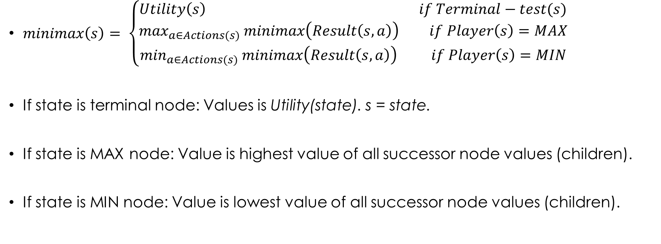
Minimax - definition
$minimax\left(s\right)= \left\{\begin{aligned}Utility\left(s\right) if Terminal−test(s) \\ \max_{a∈Actions(s)} minimax\left(Result\left(s,a\right)\right) if Player\left(s\right)=MAX \\ \min_{a∈Actions(s)} minimax\left(Result\left(s,a\right)\right) if Player\left(s\right)=MIN\end{aligned}\right.$
If state is terminal node: Values is Utility(state). s = state.
If state is MAX node: Value is highest value of all successor node values (children).
If state is MIN node: Value is lowest value of all successor node values (children).

Slide 15
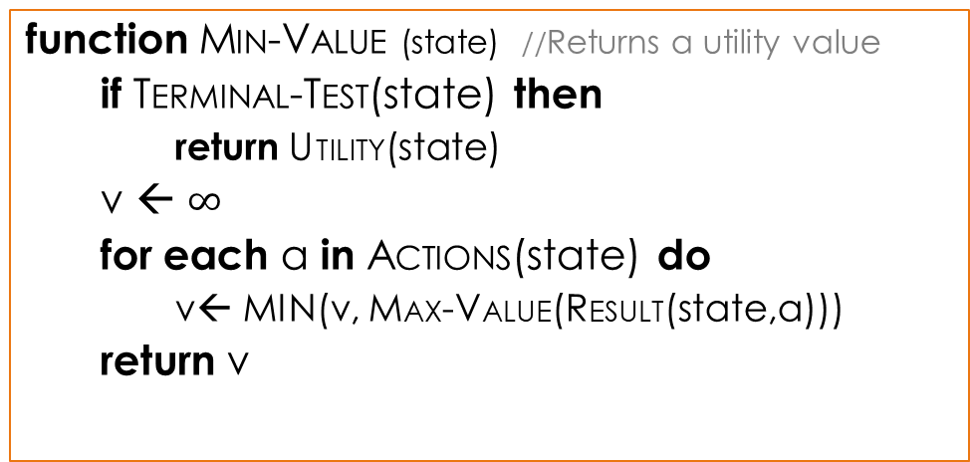
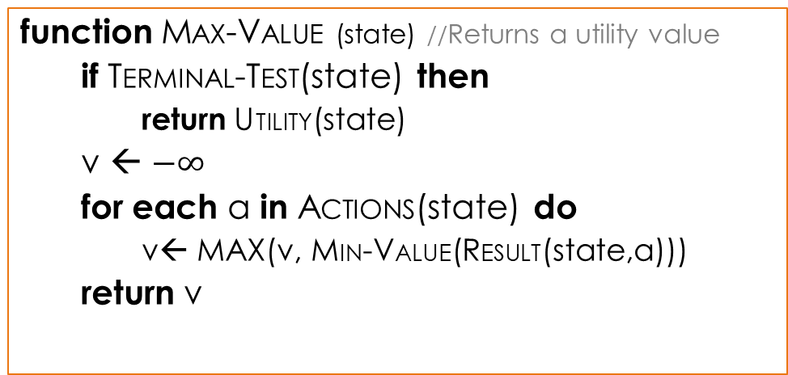
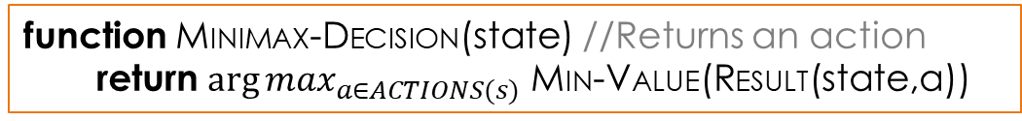
Minimax - Algorithm
function MAX-VALUE (state) //Returns a utility value
if TERMINAL-TEST(state) then
return UTILITY(state)
v ← $−∞$
for each a in ACTIONS(state) do
v← MAX(v, MIN-VALUE(RESULT(state,a)))
return v
function MIN-VALUE (state) //Returns a utility value
if TERMINAL-TEST(state) then
return UTILITY(state)
v ← $∞$
for each a in ACTIONS(state) do
v← MIN(v, MAX-VALUE(RESULT(state,a)))
return v
function MINIMAX-DECISION(state) //Returns an action
return $\arg{\max_{a∈ACTIONS(s)}}$ MIN-VALUE(RESULT(state,a))

Slide 16
Minimax - properties
Complete?
Optimality?
Time complexity?
Space complexity?

Slide 17

Minimax - properties
Complete?: Yes, if tree is finite
Optimality?: Yes, against an optimal opponent.
Time complexity?: O($b^{m}$)
Space complexity?: O($bm$)

Slide 18
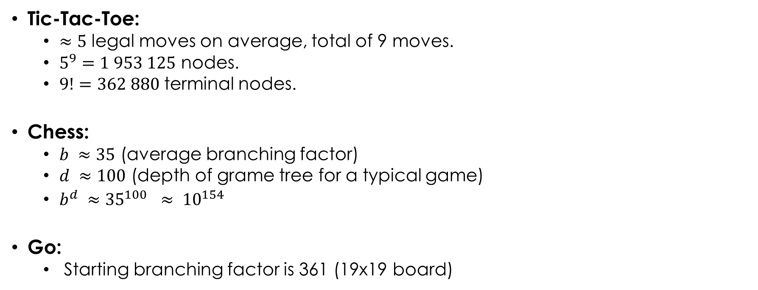
Minimax - Issue
Tic-Tac-Toe:
$≈5$ legal moves on average, total of 9 moves.
$5^{9}=1 953 125$ nodes.
$9!=362 880$terminal nodes.
Chess:
$b ≈35$ (average branching factor)
$d ≈100$ (depth of grame tree for a typical game)
$b^{d} ≈{35}^{100} ≈ {10}^{154}$
Go:
Starting branching factor is 361 (19x19 board)

Slide 19
Minimax – issue (2)
Problem: In real games, we are time limited.
To be able to run in a reasonable time, minimax should be limited in depth.
Solution:
Use pruning: eliminate large parts of the tree
Replace terminal utilities with an evaluation function for non-terminal positions.

Slide 20


$α−β pruning$ - Intuition
MAX
[-, +]
A
$$a_{1}$$
$$a_{3}$$
$$a_{2}$$
MIN
B
[-, +]
C
[-, +]
D
[-, +]
$$b_{1}$$
$$b_{3}$$
$$c_{1}$$
$$c_{3}$$
$$d_{1}$$
$$d_{3}$$
$$b_{2}$$
$$c_{2}$$
$$d_{2}$$

Slide 21
$α−β pruning$ - Intuition
MAX
[-, +]
A
$$a_{1}$$
$$a_{3}$$
$$a_{2}$$
MIN
B
C
D
[-, 3]
3
[-, +]
[-, +]
$$b_{1}$$
$$b_{3}$$
$$c_{1}$$
$$c_{3}$$
$$d_{1}$$
$$d_{3}$$
$$b_{2}$$
$$c_{2}$$
$$d_{2}$$
3

Slide 22
$α−β pruning$ - Intuition
MAX
[-, +]
A
$$a_{1}$$
$$a_{3}$$
$$a_{2}$$
MIN
B
C
D
[-, 3]
3
[-, +]
[-, +]
$$b_{1}$$
$$b_{3}$$
$$c_{1}$$
$$c_{3}$$
$$d_{1}$$
$$d_{3}$$
$$b_{2}$$
$$c_{2}$$
$$d_{2}$$
3
12

Slide 23
$α−β pruning$ - Intuition
MAX
[-, +]
A
$$a_{1}$$
$$a_{3}$$
$$a_{2}$$
MIN
B
C
D
[3, 3]
3
[-, +]
[-, +]
$$b_{1}$$
$$b_{3}$$
$$c_{1}$$
$$c_{3}$$
$$d_{1}$$
$$d_{3}$$
$$b_{2}$$
$$c_{2}$$
$$d_{2}$$
3
12
8

Slide 24
$α−β pruning$ - Intuition
MAX
[3, +]
A
3
$$a_{1}$$
$$a_{3}$$
$$a_{2}$$
MIN
B
C
D
[3, 3]
3
[-, +]
[-, +]
$$b_{1}$$
$$b_{3}$$
$$c_{1}$$
$$c_{3}$$
$$d_{1}$$
$$d_{3}$$
$$b_{2}$$
$$c_{2}$$
$$d_{2}$$
3
12
8

Slide 25
$α−β pruning$ - Intuition
MAX
[3, +]
A
3
$$a_{1}$$
$$a_{3}$$
$$a_{2}$$
MIN
B
C
D
[3, 3]
3
[-, 2]
2
[-, +]
$$b_{1}$$
$$b_{3}$$
$$c_{1}$$
$$c_{3}$$
$$d_{1}$$
$$d_{3}$$
$$b_{2}$$
$$c_{2}$$
$$d_{2}$$
3
12
8
2

Slide 26
$α−β pruning$ - Intuition
MAX
[3, 5]
A
3
$$a_{1}$$
$$a_{3}$$
$$a_{2}$$
MIN
B
C
D
[3, 3]
3
[-, 2]
2
[-, 5]
5
$$b_{1}$$
$$b_{3}$$
$$c_{1}$$
$$c_{3}$$
$$d_{1}$$
$$d_{3}$$
$$b_{2}$$
$$c_{2}$$
$$d_{2}$$
3
12
8
2
5

Slide 27
$α−β pruning$ - Intuition
MAX
[3, 3]
A
3
$$a_{1}$$
$$a_{3}$$
$$a_{2}$$
MIN
B
C
D
[3, 3]
3
[-, 2]
2
[-, 2]
2
$$b_{1}$$
$$b_{3}$$
$$c_{1}$$
$$c_{3}$$
$$d_{1}$$
$$d_{3}$$
$$b_{2}$$
$$c_{2}$$
$$d_{2}$$
3
12
8
2
5
2

Slide 28
$α−β pruning$ - Intuition
MAX
[3, 3]
A
3
$$a_{1}$$
$$a_{3}$$
$$a_{2}$$
MIN
B
C
D
[3, 3]
3
[-, 2]
2
[-, 2]
2
$$b_{1}$$
$$b_{3}$$
$$c_{1}$$
$$c_{3}$$
$$d_{1}$$
$$d_{3}$$
$$b_{2}$$
$$c_{2}$$
$$d_{2}$$
3
12
8
2
x
y
5
2
z

Slide 29

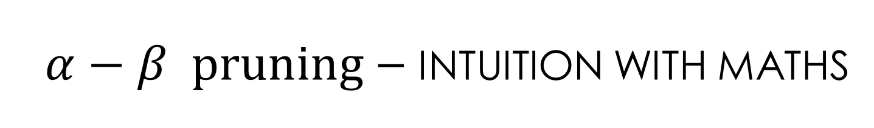
$α−β pruning$ – Intuition with maths
$$MINIMAX (root) =max\left( min\left(3, 12, 8\right), min\left(2,x,y\right), min(5, 2, z) \right)$$
$$=max⁡(3,\min\left(2,x,y\right), min⁡(5, 2,z))$$
$$=\max\left(3, a, b\right)where a=\min\left(2, x, y\right)≤2 and b=\min\left(5, 2,z\right)≤2$$
$$=3$$

Slide 30
$α−β pruning$ - Intuition
MAX
[3, 3]
A
3
$$a_{1}$$
$$a_{3}$$
$$a_{2}$$
MIN
B
C
D
[3, 3]
3
[2, 2]
2
[2, 2]
2
$$b_{1}$$
$$b_{3}$$
$$c_{1}$$
$$c_{3}$$
$$d_{1}$$
$$d_{3}$$
$$b_{2}$$
$$c_{2}$$
$$d_{2}$$
3
12
8
2
4
6
5
2
14

Slide 31
$α−β pruning$ - Intuition
MAX
[3, 3]
A
3
$$a_{1}$$
$$a_{3}$$
$$a_{2}$$
MIN
B
C
D
[3, 3]
3
[1, 1]
1
[0, 0]
0
$$b_{1}$$
$$b_{3}$$
$$c_{1}$$
$$c_{3}$$
$$d_{1}$$
$$d_{3}$$
$$b_{2}$$
$$c_{2}$$
$$d_{2}$$
3
12
8
2
1
6
5
2
0

Slide 32
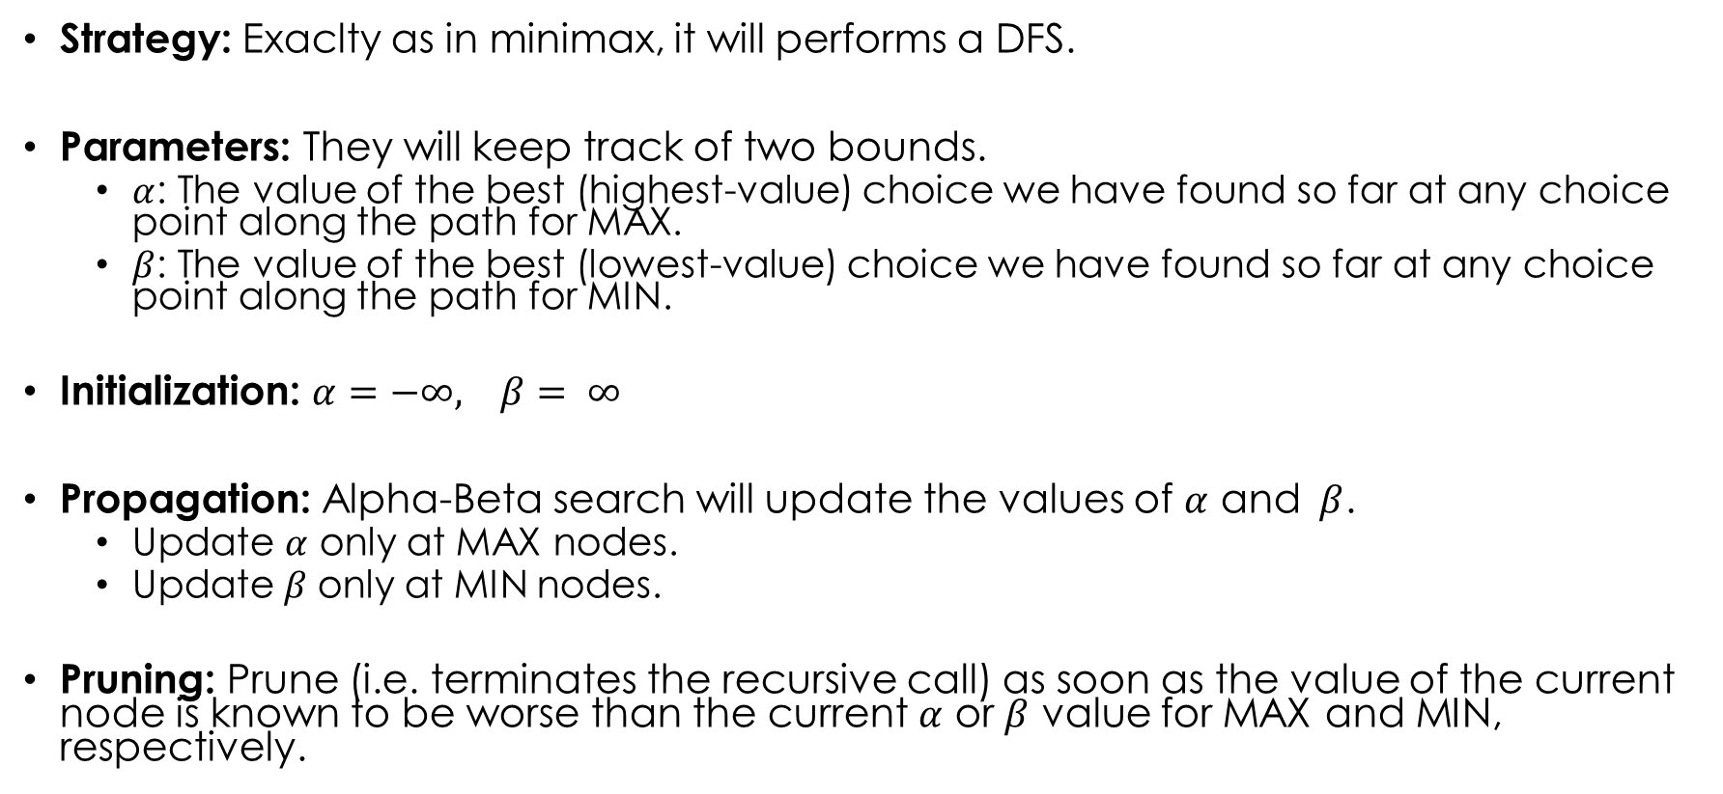

$α−β search$ - Definition
Strategy: Exaclty as in minimax, it will performs a DFS.
Parameters: They will keep track of two bounds.
$α$: The value of the best (highest-value) choice we have found so far at any choice point along the path for MAX.
$β$: The value of the best (lowest-value) choice we have found so far at any choice point along the path for MIN.
Initialization: $α=−∞, β= ∞$
Propagation: Alpha-Beta search will update the values of $α$ and $β$.
Update $α$ only at MAX nodes.
Update$β$ only at MIN nodes.
Pruning: Prune (i.e. terminates the recursive call) as soon as the value of the current node is known to be worse than the current $α$ or $β$ value for MAX and MIN, respectively.

Slide 33
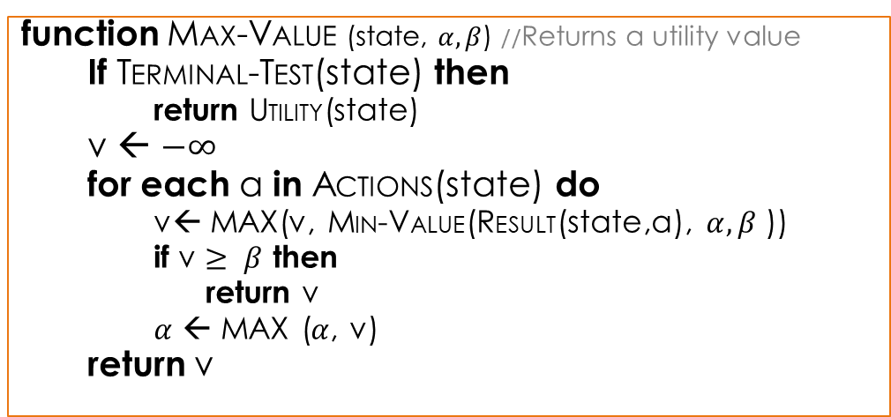

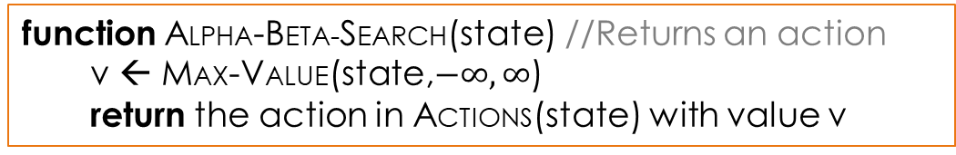
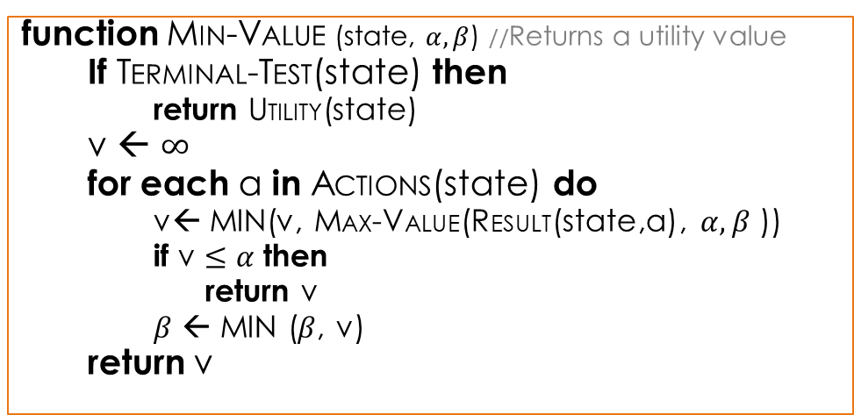
$α−β search$ - Algorithm
function MAX-VALUE (state, $α, β$) //Returns a utility value
If TERMINAL-TEST(state) then
return UTILITY(state)
v ← $−∞$
for each a in ACTIONS(state) do
v← MAX(v, MIN-VALUE(RESULT(state,a), $α, β$ ))
if v $≥ β$ then
return v
$α$ ← MAX ($α$, v)
return v
function MIN-VALUE (state, $α, β$) //Returns a utility value
If TERMINAL-TEST(state) then
return UTILITY(state)
v ← $∞$
for each a in ACTIONS(state) do
v← MIN(v, MAX-VALUE(RESULT(state,a), $α, β$ ))
if v $≤α$then
return v
$β$ ← MIN ($β$, v)
return v
function ALPHA-BETA-SEARCH(state) //Returns an action
v ← MAX-VALUE(state,$−∞, ∞$)
return the action in ACTIONS(state) with value v

Slide 34
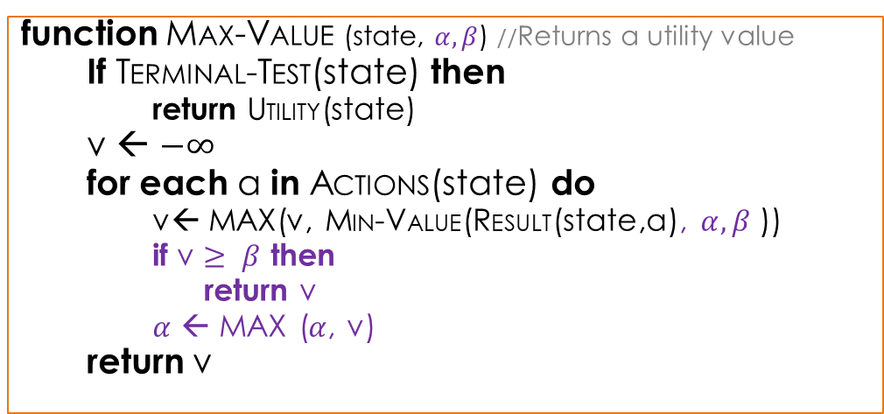
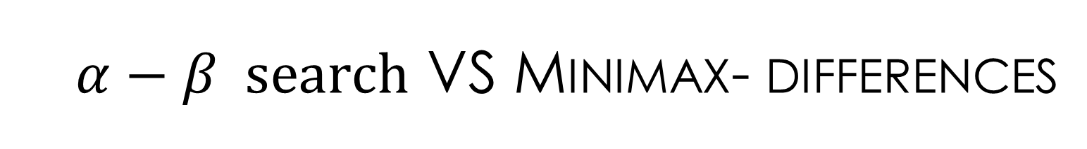
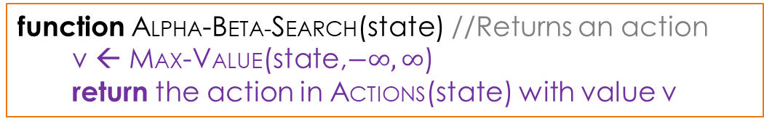
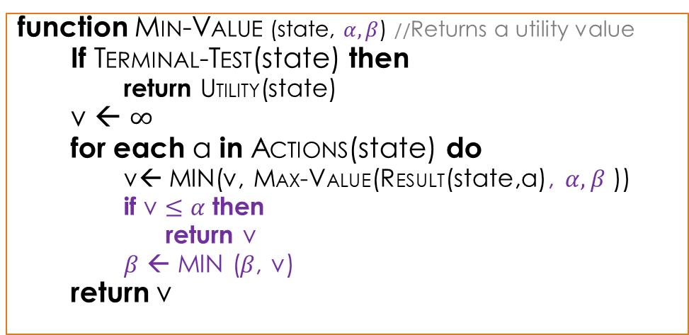
$α−β search$ vs minimax- differences
function MAX-VALUE (state, $α, β$) //Returns a utility value
If TERMINAL-TEST(state) then
return UTILITY(state)
v ← $−∞$
for each a in ACTIONS(state) do
v← MAX(v, MIN-VALUE(RESULT(state,a), $α, β$ ))
if v $≥ β$ then
return v
$α$ ← MAX ($α$, v)
return v
function MIN-VALUE (state, $α, β$) //Returns a utility value
If TERMINAL-TEST(state) then
return UTILITY(state)
v ← $∞$
for each a in ACTIONS(state) do
v← MIN(v, MAX-VALUE(RESULT(state,a), $α, β$ ))
if v $≤α$then
return v
$β$ ← MIN ($β$, v)
return v
function ALPHA-BETA-SEARCH(state) //Returns an action
v ← MAX-VALUE(state,$−∞, ∞$)
return the action in ACTIONS(state) with value v

Slide 35





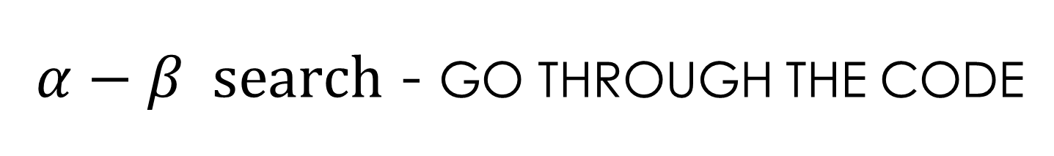








$α−β search$ - Go through the code
function ALPHA-BETA-SEARCH(A)
v ← MAX-VALUE(A,$−∞, ∞$)
return the action in ACTIONS(state) with value v
A
$$a_{1}$$
$$a_{3}$$
$$a_{2}$$
B
C
D
$$b_{1}$$
$$b_{3}$$
$$c_{1}$$
$$c_{3}$$
$$d_{1}$$
$$d_{3}$$
$$b_{2}$$
$$c_{2}$$
$$d_{2}$$
E
F
G
H
I
J
K
L
M

Slide 36


$α−β search$ - Go through the code
function MAX-VALUE (state, $α, β$) //Returns a utility value
If TERMINAL-TEST(state) then
return UTILITY(state)
v ← $−∞$
for each a in ACTIONS(state) do
v← MAX(v, MIN-VALUE(RESULT(state,a), $α, β$ ))
if v $≥ β$ then
return v
$α$ ← MAX ($α$, v)
return v
A
False
$$a_{1}$$
$$a_{3}$$
$$a_{2}$$
B
C
D
$$b_{1}$$
$$b_{3}$$
$$c_{1}$$
$$c_{3}$$
$$d_{1}$$
$$d_{3}$$
$$b_{2}$$
$$c_{2}$$
$$d_{2}$$
Variables:
state = A
$α=−∞$
$β= ∞$
E
F
G
H
I
J
K
L
M

Slide 37

$α−β search$ - Go through the code
function MAX-VALUE (state, $α, β$) //Returns a utility value
If TERMINAL-TEST(state) then
return UTILITY(state)
v ← $−∞$
for each a in ACTIONS(state) do
v← MAX(v, MIN-VALUE(RESULT(state,a), $α, β$ ))
if v $≥ β$ then
return v
$α$ ← MAX ($α$, v)
return v
A
B
$$a_{1}$$
$$a_{3}$$
$$a_{2}$$
B
C
D
$$b_{1}$$
$$b_{3}$$
$$c_{1}$$
$$c_{3}$$
$$d_{1}$$
$$d_{3}$$
$$b_{2}$$
$$c_{2}$$
$$d_{2}$$
Variables:
state = A
$α=−∞$
$β= ∞$
v = $−∞$
a = $a_{1}$
E
F
G
H
I
J
K
L
M

Slide 38


$α−β search$ - Go through the code
function MIN-VALUE (state, $α, β$) //Returns a utility value
If TERMINAL-TEST(state) then
return UTILITY(state)
v ← $∞$
for each a in ACTIONS(state) do
v← MIN(v, MAX-VALUE(RESULT(state,a), $α, β$ ))
if v $≤α$then
return v
$β$ ← MIN ($β$, v)
return v
A
False
$$a_{1}$$
$$a_{3}$$
$$a_{2}$$
B
C
D
$$b_{1}$$
$$b_{3}$$
$$c_{1}$$
$$c_{3}$$
$$d_{1}$$
$$d_{3}$$
$$b_{2}$$
$$c_{2}$$
$$d_{2}$$
Variables:
state = B
$α=−∞$
$β= ∞$
E
F
G
H
I
J
K
L
M

Slide 39

$α−β search$ - Go through the code
function MIN-VALUE (state, $α, β$) //Returns a utility value
If TERMINAL-TEST(state) then
return UTILITY(state)
v ← $∞$
for each a in ACTIONS(state) do
v← MIN(v, MAX-VALUE(RESULT(state,a), $α, β$ ))
if v $≤α$then
return v
$β$ ← MIN ($β$, v)
return v
A
E
$$a_{1}$$
$$a_{3}$$
$$a_{2}$$
B
C
D
$$b_{1}$$
$$b_{3}$$
$$c_{1}$$
$$c_{3}$$
$$d_{1}$$
$$d_{3}$$
$$b_{2}$$
$$c_{2}$$
$$d_{2}$$
Variables:
state = B
$α=−∞$
$β= ∞$
v = $∞$
a = $b_{1}$
E
F
G
H
I
J
K
L
M

Slide 40

$α−β search$ - Go through the code
function MAX-VALUE (state, $α, β$) //Returns a utility value
If TERMINAL-TEST(state) then
return UTILITY(state)
v ← $−∞$
for each a in ACTIONS(state) do
v← MAX(v, MIN-VALUE(RESULT(state,a), $α, β$ ))
if v $≥ β$ then
return v
$α$ ← MAX ($α$, v)
return v
A
True
$$a_{1}$$
$$a_{3}$$
$$a_{2}$$
B
C
D
$$b_{1}$$
$$b_{3}$$
$$c_{1}$$
$$c_{3}$$
$$d_{1}$$
$$d_{3}$$
$$b_{2}$$
$$c_{2}$$
$$d_{2}$$
Variables:
state = E
$α=−∞$
$β= ∞$
E
F
G
H
I
J
K
L
M

Slide 41

$α−β search$ - Go through the code
function MAX-VALUE (state, $α, β$) //Returns a utility value
If TERMINAL-TEST(state) then
return UTILITY(state)
v ← $−∞$
for each a in ACTIONS(state) do
v← MAX(v, MIN-VALUE(RESULT(state,a), $α, β$ ))
if v $≥ β$ then
return v
$α$ ← MAX ($α$, v)
return v
A
3
$$a_{1}$$
$$a_{3}$$
$$a_{2}$$
B
C
D
$$b_{1}$$
$$b_{3}$$
$$c_{1}$$
$$c_{3}$$
$$d_{1}$$
$$d_{3}$$
$$b_{2}$$
$$c_{2}$$
$$d_{2}$$
Variables:
state = E
$α=−∞$
$β= ∞$
3
F
G
H
I
J
K
L
M

Slide 42

$α−β search$ - Go through the code
function MIN-VALUE (state, $α, β$) //Returns a utility value
If TERMINAL-TEST(state) then
return UTILITY(state)
v ← $∞$
for each a in ACTIONS(state) do
v← MIN(v, MAX-VALUE(RESULT(state,a), $α, β$ ))
if v $≤α$then
return v
$β$ ← MIN ($β$, v)
return v
A
$$a_{1}$$
$$a_{3}$$
$$a_{2}$$
B
C
D
3
$$b_{1}$$
$$b_{3}$$
$$c_{1}$$
$$c_{3}$$
$$d_{3}$$
$$d_{1}$$
$$b_{2}$$
$$c_{2}$$
$$d_{2}$$
Variables:
state = B
$α=−∞$
$β= ∞$
v = $∞$
a = $b_{1}$
Variables:
state = B
$α=−∞$
$β= ∞$
v = $∞$ 3
a = $b_{1}$
3
F
G
H
I
J
K
L
M

Slide 43


$α−β search$ - Go through the code
function MIN-VALUE (state, $α, β$) //Returns a utility value
If TERMINAL-TEST(state) then
return UTILITY(state)
v ← $∞$
for each a in ACTIONS(state) do
v← MIN(v, MAX-VALUE(RESULT(state,a), $α, β$ ))
if v $≤α$then
return v
$β$ ← MIN ($β$, v)
return v
A
$$a_{1}$$
$$a_{3}$$
$$a_{2}$$
3
C
D
False
$$b_{1}$$
$$b_{3}$$
$$c_{1}$$
$$c_{3}$$
$$d_{1}$$
$$d_{3}$$
$$b_{2}$$
$$c_{2}$$
$$d_{2}$$
Variables:
state = B
$α=−∞$
$β= ∞$
v = $3$
a = $b_{1}$
3
F
G
H
I
J
K
L
M

Slide 44


$α−β search$ - Go through the code
function MIN-VALUE (state, $α, β$) //Returns a utility value
If TERMINAL-TEST(state) then
return UTILITY(state)
v ← $∞$
for each a in ACTIONS(state) do
v← MIN(v, MAX-VALUE(RESULT(state,a), $α, β$ ))
if v $≤α$then
return v
$β$ ← MIN ($β$, v)
return v
A
$$a_{1}$$
$$a_{3}$$
$$a_{2}$$
3
C
D
$$b_{1}$$
$$b_{3}$$
$$c_{1}$$
$$c_{3}$$
$$d_{1}$$
$$d_{3}$$
$$b_{2}$$
$$c_{2}$$
$$d_{2}$$
Variables:
state = B
$α=−∞$
$β= ∞$
v = $3$
a = $b_{1}$
Variables:
state = B
$α=−∞$
$β= ∞ 3$
v = $3$
a = $b_{1}$
3
F
G
H
I
J
K
L
M
3

Slide 45

$α−β search$ - Go through the code
function MIN-VALUE (state, $α, β$) //Returns a utility value
If TERMINAL-TEST(state) then
return UTILITY(state)
v ← $∞$
for each a in ACTIONS(state) do
v← MIN(v, MAX-VALUE(RESULT(state,a), $α, β$ ))
if v $≤α$then
return v
$β$ ← MIN ($β$, v)
return v
A
F
$$a_{1}$$
$$a_{3}$$
$$a_{2}$$
3
C
D
$$b_{1}$$
$$b_{3}$$
$$c_{1}$$
$$c_{3}$$
$$d_{1}$$
$$d_{3}$$
$$b_{2}$$
$$c_{2}$$
$$d_{2}$$
Variables:
state = B
$α=−∞$
$β=3$
v = $3$
a = $b_{2}$
3
F
G
H
I
J
K
L
M

Slide 46

$α−β search$ - Go through the code
function MAX-VALUE (state, $α, β$) //Returns a utility value
If TERMINAL-TEST(state) then
return UTILITY(state)
v ← $−∞$
for each a in ACTIONS(state) do
v← MAX(v, MIN-VALUE(RESULT(state,a), $α, β$ ))
if v $≥ β$ then
return v
$α$ ← MAX ($α$, v)
return v
A
True
$$a_{1}$$
$$a_{3}$$
$$a_{2}$$
3
C
D
$$b_{1}$$
$$b_{3}$$
$$c_{1}$$
$$c_{3}$$
$$d_{1}$$
$$d_{3}$$
$$b_{2}$$
$$c_{2}$$
$$d_{2}$$
Variables:
state = F
$α=−∞$
$β=3$
3
F
G
H
I
J
K
L
M

Slide 47
$α−β search$ - Go through the code
function MAX-VALUE (state, $α, β$) //Returns a utility value
If TERMINAL-TEST(state) then
return UTILITY(state)
v ← $−∞$
for each a in ACTIONS(state) do
v← MAX(v, MIN-VALUE(RESULT(state,a), $α, β$ ))
if v $≥ β$ then
return v
$α$ ← MAX ($α$, v)
return v
A
12
$$a_{1}$$
$$a_{3}$$
$$a_{2}$$
3
C
D
$$b_{1}$$
$$b_{3}$$
$$c_{1}$$
$$c_{3}$$
$$d_{1}$$
$$d_{3}$$
$$b_{2}$$
$$c_{2}$$
$$d_{2}$$
Variables:
state = F
$α=−∞$
$β=3$
3
12
G
H
I
J
K
L
M

Slide 48
$α−β search$ - Go through the code
function MIN-VALUE (state, $α, β$) //Returns a utility value
If TERMINAL-TEST(state) then
return UTILITY(state)
v ← $∞$
for each a in ACTIONS(state) do
v← MIN(v, MAX-VALUE(RESULT(state,a), $α, β$ ))
if v $≤α$then
return v
$β$ ← MIN ($β$, v)
return v
A
$$a_{1}$$
$$a_{3}$$
$$a_{2}$$
3
C
D
12
$$b_{1}$$
$$b_{3}$$
$$c_{1}$$
$$c_{3}$$
$$d_{3}$$
$$d_{1}$$
$$b_{2}$$
$$c_{2}$$
$$d_{2}$$
Variables:
state = B
$α=−∞$
$β=3$
v = $3$
a = $b_{2}$
3
12
G
H
I
J
K
L
M

Slide 49
$α−β search$ - Go through the code
function MIN-VALUE (state, $α, β$) //Returns a utility value
If TERMINAL-TEST(state) then
return UTILITY(state)
v ← $∞$
for each a in ACTIONS(state) do
v← MIN(v, MAX-VALUE(RESULT(state,a), $α, β$ ))
if v $≤α$then
return v
$β$ ← MIN ($β$, v)
return v
A
$$a_{1}$$
$$a_{3}$$
$$a_{2}$$
3
C
D
False
$$b_{1}$$
$$b_{3}$$
$$c_{1}$$
$$c_{3}$$
$$d_{1}$$
$$d_{3}$$
$$b_{2}$$
$$c_{2}$$
$$d_{2}$$
Variables:
state = B
$α=−∞$
$β=3$
v = $3$
a = $b_{2}$
3
12
G
H
I
J
K
L
M

Slide 50

$α−β search$ - Go through the code
function MIN-VALUE (state, $α, β$) //Returns a utility value
If TERMINAL-TEST(state) then
return UTILITY(state)
v ← $∞$
for each a in ACTIONS(state) do
v← MIN(v, MAX-VALUE(RESULT(state,a), $α, β$ ))
if v $≤α$then
return v
$β$ ← MIN ($β$, v)
return v
A
G
$$a_{1}$$
$$a_{3}$$
$$a_{2}$$
3
C
D
8
$$b_{1}$$
$$b_{3}$$
$$c_{1}$$
$$c_{3}$$
$$d_{1}$$
$$d_{3}$$
$$b_{2}$$
$$c_{2}$$
$$d_{2}$$
Variables:
state = B
$α=−∞$
$β=3$
v = $3$
a = $b_{3}$
3
12
8
H
I
J
K
L
M

Slide 51

$α−β search$ - Go through the code
function MIN-VALUE (state, $α, β$) //Returns a utility value
If TERMINAL-TEST(state) then
return UTILITY(state)
v ← $∞$
for each a in ACTIONS(state) do
v← MIN(v, MAX-VALUE(RESULT(state,a), $α, β$ ))
if v $≤α$then
return v
$β$ ← MIN ($β$, v)
return v
A
$$a_{1}$$
$$a_{3}$$
$$a_{2}$$
3
C
D
$$b_{1}$$
$$b_{3}$$
$$c_{1}$$
$$c_{3}$$
$$d_{1}$$
$$d_{3}$$
$$b_{2}$$
$$c_{2}$$
$$d_{2}$$
Variables:
state = B
$α=−∞$
$β=3$
v = $3$
a = $b_{3}$
3
12
8
H
I
J
K
L
M

Slide 52

$α−β search$ - Go through the code
function MAX-VALUE (state, $α, β$) //Returns a utility value
If TERMINAL-TEST(state) then
return UTILITY(state)
v ← $−∞$
for each a in ACTIONS(state) do
v← MAX(v, MIN-VALUE(RESULT(state,a), $α, β$ ))
if v $≥ β$ then
return v
$α$ ← MAX ($α$, v)
return v
A
$$a_{1}$$
$$a_{3}$$
$$a_{2}$$
3
C
D
3
$$b_{1}$$
$$b_{3}$$
$$c_{1}$$
$$c_{3}$$
$$d_{1}$$
$$d_{3}$$
$$b_{2}$$
$$c_{2}$$
$$d_{2}$$
Variables:
state = A
$α=−∞$
$β= ∞$
v = $−∞$
a = $a_{1}$
Variables:
state = A
$α=−∞$
$β= ∞$
v = -$∞ 3$
a = $a_{1}$
3
12
8
H
I
J
K
L
M

Slide 53


$α−β search$ - Go through the code
function MAX-VALUE (state, $α, β$) //Returns a utility value
If TERMINAL-TEST(state) then
return UTILITY(state)
v ← $−∞$
for each a in ACTIONS(state) do
v← MAX(v, MIN-VALUE(RESULT(state,a), $α, β$ ))
if v $≥ β$ then
return v
$α$ ← MAX ($α$, v)
return v
3
$$a_{1}$$
$$a_{3}$$
$$a_{2}$$
3
C
D
False
$$b_{1}$$
$$b_{3}$$
$$c_{1}$$
$$c_{3}$$
$$d_{1}$$
$$d_{3}$$
$$b_{2}$$
$$c_{2}$$
$$d_{2}$$
Variables:
state = A
$α=−∞$
$β= ∞$
v = $3$
a = $a_{1}$
3
12
8
H
I
J
K
L
M

Slide 54


$α−β search$ - Go through the code
function MAX-VALUE (state, $α, β$) //Returns a utility value
If TERMINAL-TEST(state) then
return UTILITY(state)
v ← $−∞$
for each a in ACTIONS(state) do
v← MAX(v, MIN-VALUE(RESULT(state,a), $α, β$ ))
if v $≥ β$ then
return v
$α$ ← MAX ($α$, v)
return v
3
$$a_{1}$$
$$a_{3}$$
$$a_{2}$$
3
C
D
$$b_{1}$$
$$b_{3}$$
$$c_{1}$$
$$c_{3}$$
$$d_{1}$$
$$d_{3}$$
$$b_{2}$$
$$c_{2}$$
$$d_{2}$$
Variables:
state = A
$α=−∞$
$β= ∞$
v = $3$
a = $a_{1}$
Variables:
state = A
$α=−∞ 3$
$β= ∞$
v = $3$
a = $a_{1}$
3
12
8
H
I
J
K
L
M
3

Slide 55


$α−β search$ - Go through the code
function MAX-VALUE (state, $α, β$) //Returns a utility value
If TERMINAL-TEST(state) then
return UTILITY(state)
v ← $−∞$
for each a in ACTIONS(state) do
v← MAX(v, MIN-VALUE(RESULT(state,a), $α, β$ ))
if v $≥ β$ then
return v
$α$ ← MAX ($α$, v)
return v
3
$$a_{1}$$
$$a_{3}$$
C
$$a_{2}$$
3
C
D
$$b_{1}$$
$$b_{3}$$
$$c_{1}$$
$$c_{3}$$
$$d_{1}$$
$$d_{3}$$
$$b_{2}$$
$$c_{2}$$
$$d_{2}$$
Variables:
state = A
$α=3$
$β= ∞$
v = $3$
a = $a_{2}$
3
12
8
H
I
J
K
L
M

Slide 56


$α−β search$ - Go through the code
function MIN-VALUE (state, $α, β$) //Returns a utility value
If TERMINAL-TEST(state) then
return UTILITY(state)
v ← $∞$
for each a in ACTIONS(state) do
v← MIN(v, MAX-VALUE(RESULT(state,a), $α, β$ ))
if v $≤α$then
return v
$β$ ← MIN ($β$, v)
return v
3
False
$$a_{1}$$
$$a_{3}$$
$$a_{2}$$
3
C
D
$$b_{1}$$
$$b_{3}$$
$$c_{1}$$
$$c_{3}$$
$$d_{1}$$
$$d_{3}$$
$$b_{2}$$
$$c_{2}$$
$$d_{2}$$
Variables:
state = C
$α=3$
$β= ∞$
3
12
8
H
I
J
K
L
M

Slide 57



$α−β search$ - Go through the code
function MIN-VALUE (state, $α, β$) //Returns a utility value
If TERMINAL-TEST(state) then
return UTILITY(state)
v ← $∞$
for each a in ACTIONS(state) do
v← MIN(v, MAX-VALUE(RESULT(state,a), $α, β$ ))
if v $≤α$then
return v
$β$ ← MIN ($β$, v)
return v
3
H
$$a_{1}$$
$$a_{2}$$
$$a_{3}$$
3
C
D
2
$$b_{1}$$
$$b_{3}$$
$$c_{1}$$
$$c_{3}$$
$$d_{1}$$
$$d_{3}$$
$$b_{2}$$
$$c_{2}$$
$$d_{2}$$
Variables:
state = C
$α=3$
$β= ∞$
v = $∞ 2$
a = $c_{1}$
Variables:
state = C
$α=3$
$β= ∞$
v = $∞$
a = $c_{1}$
3
12
8
2
I
J
K
L
M

Slide 58


$α−β search$ - Go through the code
function MIN-VALUE (state, $α, β$) //Returns a utility value
If TERMINAL-TEST(state) then
return UTILITY(state)
v ← $∞$
for each a in ACTIONS(state) do
v← MIN(v, MAX-VALUE(RESULT(state,a), $α, β$ ))
if v $≤α$then
return v
$β$ ← MIN ($β$, v)
return v
3
$$a_{1}$$
$$a_{3}$$
$$a_{2}$$
3
2
D
True
$$b_{1}$$
$$b_{3}$$
$$c_{1}$$
$$c_{3}$$
$$d_{1}$$
$$d_{3}$$
$$b_{2}$$
$$c_{2}$$
$$d_{2}$$
Variables:
state = C
$α=3$
$β= ∞$
v = $2$
a = $c_{1}$
3
12
8
2
I
J
K
L
M

Slide 59
$α−β search$ - Go through the code
function MIN-VALUE (state, $α, β$) //Returns a utility value
If TERMINAL-TEST(state) then
return UTILITY(state)
v ← $∞$
for each a in ACTIONS(state) do
v← MIN(v, MAX-VALUE(RESULT(state,a), $α, β$ ))
if v $≤α$then
return v
$β$ ← MIN ($β$, v)
return v
3
$$a_{1}$$
$$a_{3}$$
$$a_{2}$$
3
2
D
$$b_{1}$$
$$b_{3}$$
$$c_{1}$$
$$c_{3}$$
$$d_{1}$$
$$d_{3}$$
$$b_{2}$$
$$c_{2}$$
$$d_{2}$$
Variables:
state = C
$α=3$
$β= ∞$
v = $2$
a = $c_{1}$
3
12
8
2
I
J
K
L
M

Slide 60
$α−β search$ - Go through the code
function MAX-VALUE (state, $α, β$) //Returns a utility value
If TERMINAL-TEST(state) then
return UTILITY(state)
v ← $−∞$
for each a in ACTIONS(state) do
v← MAX(v, MIN-VALUE(RESULT(state,a), $α, β$ ))
if v $≥ β$ then
return v
$α$ ← MAX ($α$, v)
return v
3
$$a_{1}$$
$$a_{3}$$
$$a_{2}$$
3
2
D
2
$$b_{1}$$
$$b_{3}$$
$$c_{1}$$
$$c_{3}$$
$$d_{1}$$
$$d_{3}$$
$$b_{2}$$
$$c_{2}$$
$$d_{2}$$
Variables:
state = A
$α=3$
$β= ∞$
v = $3$
a = $a_{2}$
3
12
8
2
I
J
K
L
M

Slide 61

$α−β search$ - Go through the code
function MAX-VALUE (state, $α, β$) //Returns a utility value
If TERMINAL-TEST(state) then
return UTILITY(state)
v ← $−∞$
for each a in ACTIONS(state) do
v← MAX(v, MIN-VALUE(RESULT(state,a), $α, β$ ))
if v $≥ β$ then
return v
$α$ ← MAX ($α$, v)
return v
3
$$a_{1}$$
$$a_{3}$$
D
$$a_{2}$$
3
2
D
$$b_{1}$$
$$b_{3}$$
$$c_{1}$$
$$c_{3}$$
$$d_{1}$$
$$d_{3}$$
$$b_{2}$$
$$c_{2}$$
$$d_{2}$$
Variables:
state = A
$α=3$
$β= ∞$
v = $3$
a = $a_{3}$
3
12
8
2
I
J
K
L
M

Slide 62
$α−β search$ - Go through the code
Continue.....
3
$$a_{1}$$
$$a_{3}$$
$$a_{2}$$
3
2
2
$$b_{1}$$
$$b_{3}$$
$$c_{1}$$
$$c_{3}$$
$$d_{1}$$
$$d_{3}$$
$$b_{2}$$
$$c_{2}$$
$$d_{2}$$
3
12
8
2
I
J
5
2
M

Slide 63














$α−β search$- MOVE ORDERING
A
MAX
[3, 3]
3
We could not prune action $d_{1}$. If the leaf 2 was generated first, we would have pruned the first one (5).
Idea of ordering: Examine the successors that seems to be better.
$$a_{1}$$
$$a_{3}$$
$$a_{2}$$
MIN
3
2
2
[3, 3]
B
[-, 2]
C
[-, 2]
D
$$b_{1}$$
$$b_{3}$$
$$c_{1}$$
$$c_{3}$$
$$d_{1}$$
$$d_{3}$$
$$b_{2}$$
$$c_{2}$$
$$d_{2}$$
3
12
8
2
5
2

Slide 64


$α−β search$- MOVE ORDERING (2)
If the worst ordering is selected, no pruning happens.
The best moves will be at the right all the time
Complexity: $b^{m}$
If the ideal ordering is selected, lots of pruning happens.
The best moves are at the left all the time.
Complexity: $b^{m/2}$
With random ordering
Sometimes solutions will be at the right and sometimes at the left
Complexity: $b^{3m/4}$

Slide 65


$α−β search$- MOVE ORDERING (3)
How to find the best ordering:
Use domain knowledge to create a simple function.
i.e. In chess, captures first, then threats, then forward moves, then backward moves
Check past moves. It can be done with Iterative deepening search.
Check depth 1. Then use that information when checking depth 2 and order the nodes accordingly.
Save past moves, so we do not have to calculate them again. Like an explored list
Problem: In chess, with optimal ordering, still ${35}^{50}= {10}^{77}$ nodes. Impossible to check the whole tree.

Slide 66

Imperfect real-time decisions
The MINIMAX algorithm generates the whole game tree, while $α−β algorithm$ manage to reduce the game tree a lot.
The depth is not practical since the programs has to give an action within minutes.
Claude Shannon’s paper ”Programming a Computer for Playing Chess” (1950) proposed that programs should cutt off the search earlier and use an evaluation function instead.

Slide 67

Imperfect real-time decisions (2)
The suggestion is to alter MINIMAX or $α−β$ algorithms in two ways:
Replace the utility function by an heuristic function, Eval.
Repace the Terminal-test function by a cuttoff-test function.
$Hminimax\left(s\right)= \left\{\begin{aligned}Eval\left(s\right) if Cutoff−test(s,d) \\ \max_{a∈Actions(s)} Hminimax\left(Result\left(s,a\right),d+1\right) if Player\left(s\right)=MAX \\ \min_{a∈Actions(s)} Hminimax\left(Result\left(s,a\right),d+1\right) if Player\left(s\right)=MIN\end{aligned}\right.$
where d is the current depth.

Slide 68



Minimax – heuristic Algorithm
function MAX-VALUE (state, d) //Returns a utility value
if CUTOFF-TEST(state, d) then
return EVAL(state)
v ← $−∞$
for each a in ACTIONS(state) do
v← MAX(v, MIN-VALUE(RESULT(state,a), d+1))
return v
function MIN-VALUE (state, d) //Returns a utility value
if CUTOFF-TEST(state, d) then
return EVAL(state)
v ← $∞$
for each a in ACTIONS(state) do
v← MIN(v, MAX-VALUE(RESULT(state,a) , d+1))
return v
function MINIMAX-DECISION(state, d) //Returns an action
return $\arg{\max_{a∈ACTIONS(s)}}$ MIN-VALUE(RESULT(state,a), d+1)

Slide 69




$α−β search$ – Heuristic Algorithm
function MAX-VALUE (state, $α, β$, d) //Returns a utility value
If CUTTOFF-TEST(state, d) then
return EVAL(state)
v ← $−∞$
for each a in ACTIONS(state) do
v← MAX(v, MIN-VALUE(RESULT(state,a), $α, β$, d+1))
if v $≥ β$ then
return v
$α$ ← MAX ($α$, v)
return v
function MIN-VALUE (state, $α, β$, d) //Returns a utility value
If CUTTOFF-TEST(state, d) then
return EVAL(state)
v ← $∞$
for each a in ACTIONS(state) do
v← MIN(v, MAX-VALUE(RESULT(state,a), $α, β$, d+1))
if v $≤α$then
return v
$β$ ← MIN ($β$, v)
return v
function ALPHA-BETA-SEARCH(state) //Returns an action
v ← MAX-VALUE(state,$−∞, ∞$,1)
return the action in ACTIONS(state) with value v

Slide 70

Evaluation functions
An evaluation function returns an estimate of the expected utility.
Properties of an evaluation function:
Terminal states should be ordered on the same way as with the utility.
i.e. Wins give more points than draws, and draws give more points than losses.
The computation of the evaluation function should be fast.
For the nonterminal states, the evaluation function has to be correlated with the actual chances of winning.
Most evaluation functions work by calculating various features of a state.
A weight will be given to each feature.
Mathematically, this kind of evaluation funciton is called a weighted linear function:
$$Eval\left(s\right)= w_{1}f_{1}\left(s\right)+w_{2}f_{2}\left(s\right)+ …+w_{n}f_{n}\left(s\right)= \sum_{i=1}^{n}{w_{i}f_{i}(s)}$$
where $w_{i}$ is the weight that will affect to the i-th feature ($f_{i}(s)$) of a state, s.

Slide 71
Features – chess example
Give a value (weight) to each piece. Then, count the number of pieces that we have. For example:
Pawn: 1 point
Knight: 3 points
Bishop: 3 points
Rook: 5 points
Queen: 9 points
”Good pawn structure” or ”king safety” can worth half a pawn.
Problem: We assume that the contribution of each feature is independent.
i.e. Bishops are stronger in the endgame, giving a fix value might not be the best idea.
Solutions:
You can change the value of the bishops with the time.
Create nonlinear combinations.
i.e. A pair of bishops might be worth slightly more than twice the value of a single bishop.

Slide 72

Stochastics games
In stochastics games, unpredictability is added by using random elements.
i.e. Throwing of dice
Let’s take Backgammon as an example (2 dice):
Probability (1, 1) = 1/36.
....
Probability (6, 6) = 1/36.
Probability (1, 2) = 2/36 = 1/18.
Probability (1, 3) = 2/36 = 1/18.
....
Probability (6, 4) = 2/36 = 1/18.
Probability (6, 5) = 2/36 = 1/18.
A game tree for a stochastic game must include chance nodes. They will denote the possible dice rolls

Slide 73
Backgammon game tree
MAX
Chance
...
...
...
Prob: 1/36
Dice: 1, 1
Prob: 1/36
Dice: 6, 6
...
...
Prob: 1/18
Dice: 6, 5
Prob: 1/18
Dice: 1, 2
MIN
...
...
...
...
Chance
...
Prob: 1/36
Dice: 1, 1
Prob: 1/36
Dice: 6, 6
...
...
...
Prob: 1/18
Dice: 1, 2
Prob: 1/18
Dice: 6, 5
MAX
...
...
...
...
Terminal 2 -1 1 ... -1 1

Slide 74

Expectiminimax - definition
$expectiminimax\left(s\right)= \left\{\begin{aligned}Utility\left(s\right) if Terminal−test(s) \\ \max_{a∈Actions(s)} expectiminimax\left(Result\left(s,a\right)\right) if Player\left(s\right)=MAX \\ \min_{a∈Actions(s)} expectiminimax\left(Result\left(s,a\right)\right) if Player\left(s\right)=MIN \\ \sum_{r}{P\left(r\right)Expectiminimax}\left(Result\left(s, r\right)\right) if Player\left(s\right)=Chance\end{aligned}\right.$
where r represents a possible dice roll (or other chance event) and Result(s, r) is the same state as s, but knowing the result of the dice.
If state is terminal node: Values is Utility(state). s = state.
If state is MAX node: Value is highest value of all successor node values (children).
If state is MIN node: Value is lowest value of all successor node values (children).
If state is Chance node: Value is the summation of all successor node values by their respective probabilities.

Slide 75


Simpler game tree
1.8
MAX
$$a_{1}$$
$$a_{2}$$
Chance
1.8
1.6
0.8
0.2
0.8
0.2
MIN
2
1
1
4
Utility: 2 3 1 3 1 3 4 8

Slide 76

Simpler game tree- aggressive
8.8
MAX
$$a_{1}$$
$$a_{2}$$
Chance
1.8
8.8
0.8
0.2
0.8
0.2
MIN
2
1
1
40
Utility: 2 30 1 30 1 30 40 80

Slide 77
Montecarlo simulation
It is used to evaluate a position (state).
Start with an alpha-beta (or other) search algorithm.
From a start position, have the algorithm play thousands of games against itself, using random dice rolls.
Use the winning percentage as the utility value.

Slide 78

game programs in 2-players board games
Chess
IBM’s DEEP BLUE is well known for defeting world champion Garry Kasparov in 1996.
Over 8000 features
HYDRA is the successor of Deep Blue. It was created in 2002.
KOMODO released in 2013 won the ast 4 years the World Computer Chess Championship

Slide 79

game programs in 2-players board games
Checkers
CHINOOK defeted the long-running world champion winner, Marion Tinsley, in 1994.
Marion Tinsley after six drawn games, and Tinsley's withdrawal due to pancreatic cancer
Since 2007, Chinook has been able to play perfectly by using alpha-beta pruning and a database with 39 trillions endgame positions.

Slide 80

game programs in 2-players board games
Go
ALPHAGO is a computer game that play the game go.
It uses Monte carlo tree search, guided by a ”value network” and a ”policy network”, both implemented using deep neural network.
Reinforcement learning is used to improve its play (playing against itself).
Successors: ALPHAGO MASTER, ALPHAGO ZERO and ALPHAZERO

Slide 81
Extra reading
Norvig, Peter, and Russell, Stuart Jonathan, Artificial intelligence: A modern approach, Pearson Education, 2010 - ISBN: 9780132071482
5 Adversarial Search ---------------------------------------------------- Pag. 161
5.1 Games --------------------------------------------------------------------- Pag. 161
5.2 Optimal Decisions in Games --------------------------------------- Pag. 163
5.3 Alpha-Beta pruning --------------------------------------------------- Pag. 167
5.4 Imperfect Real-Time Decisions ------------------------------------ Pag. 171
5.5 Stochastics Games ---------------------------------------------------- Pag. 177
5.6 Partially Observable Games (optional) ------------------------ Pag. 180
5.7 State-of-Art Game Programs -------------------------------------- Pag. 185
5.8 Alternative Approaches (optional) ------------------------------ Pag. 187

